Slide 1

Smart billing system for water suppliers

Slide 2
Introduction:
Smart billing system for water suppliers is web based application system .Smart billing system is the future of automatic billing system when a customer receives water and paying the bills through RFID tags

Slide 3
Need of this project
We are paying money for so many infrastructures.some peoples bribes the money from users.
So due to this reason we need the payments to do legally.
Time will be reduced for online payments also.
rfid systems can scan multiple items simultaneosly.
rfid tags allows read and write allowing you to add or change the data.

Slide 4
Hardware
ESP8266-12E module
RFID Reader
RFID Cards
Bread Board
Jumper Wires

Slide 5
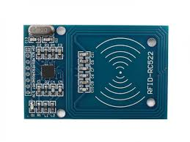
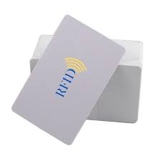
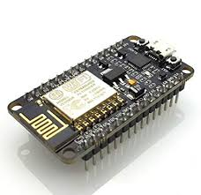
Components
RFID MODULE(READER)
RFID CARD
NODEMCU(ESP8266-12E MODULE)

Slide 6
Softwares
ARDUINO IDE
HTML , Java Script

Slide 7
RFID MODULE:
A radio frequency identification reader(RFID READER) is a device used to gather information from an RFID tag which is used to track individual objects.
Radio waves are used to transfer data from the tag to reader.
RFID is a technology similar in theory to barcodes.
The RFID tag it must be within the range of an RFID reader Which ranges from 3 to 300 feet.

Slide 8
Applications of RFID MODULE:
RFID technology may be used in a variety of applications including:
Passports
Smart cards
Home appliances
Animal and pet tags
Monitoring heart patients

Slide 9
ESP8266 MODULE(NODE MCU):
ESP8266 is a low cost WIFI module chip that can be configured to connect to the internet for internet of things and in similar technology projects.
Memory:128kbytes
Developer:ESP8266 open source community.
Operating system :XTOS
Storage:4Mbytes
NODEMCU is basically an SOC(system on chip).
SOC is an integrated circuit that integrates all components of a computer or other electronic systems.
It is a 32 bit microcontroller.
You can program the ESP8266 using Arduino , NODEMCU IDE .

Slide 10
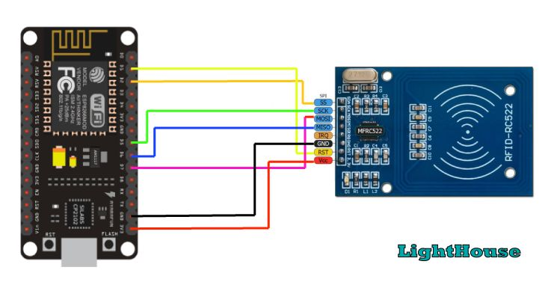
Integrating RFID MODULE with NODEMCU board:

Slide 11
DESCRIPTION
Now a days metropolitan cities operates water tanker services for delivery to residents.
They facilitate the water to residents.The person needs to pay the bills for the water that the people have used and pay for it.
Sometimes there will be a long queue that one needs to wait in order to get the water supplies bills paid.
The billing system for water suppliers will help the local government and private institutions to pay the bills without bribing.

Slide 12
RFID means Radio Frequency Identification.RFID consists of three components like scanning antenna,transceiver,rfid tag.
An rfid tag consists of microchip,memory and antenna.It uses the radio frequency to transmit the signals that activate the tag.
Here organization provides a rfid card to customer.
By scanning that card user want to enter the details about how much quantity of water required through mobile app.
If customer entered the details in the respective mobile app the price which we have to pay for the quantity of water is transferred to the supplier and remaining balance in the card is supposed to be display on mobile app.

Slide 13
Project Highlights
RFID technology
Integrating RFID module with Node MCU
Reading the data from the RFID cards
Sending HTTP request to cloud platform
Creating web application

Slide 14
Conclusion:
This proposed system gives the information about the design of RFID based water billing system
It will estimate the quantity of water required for annual use Based on this statistics we can decrease the water wastage.
Proposed system will provide accurate and real time water billing system.
This overcomes existing systems in terms of cost and manpower required.

